Slide 1
Using Updated Sinking Speed Model of Diatoms to Estimate Carbon Flux
Sue, Henry , Britten, Gregory L. , Primeau, Francois
11/08/2017

Slide 2
Goals
Estimate Carbon Flux using parameters that can be collected using remote sensing
Estimate Carbon Flux using parameters that do not depend on NPP
Generate a sinking speed model that more accurately fits data.

Slide 3

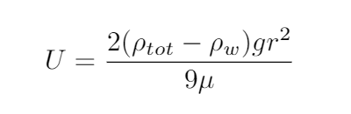
Creating a model
Stokes’ Law
ρtot is Density of Cell
ρw is Density of Water
(Approx. 1023 kg/m³)
g is gravitational constant
(9.8 m/s²)
μ is dynamic viscosity of seawater
(1.07 x 10⁻³ Pa•s at 20° C, 33 g/L Salinity)
Miklasz and Denny, (2010). Hopkins Marine Station of Stanford University

Slide 4
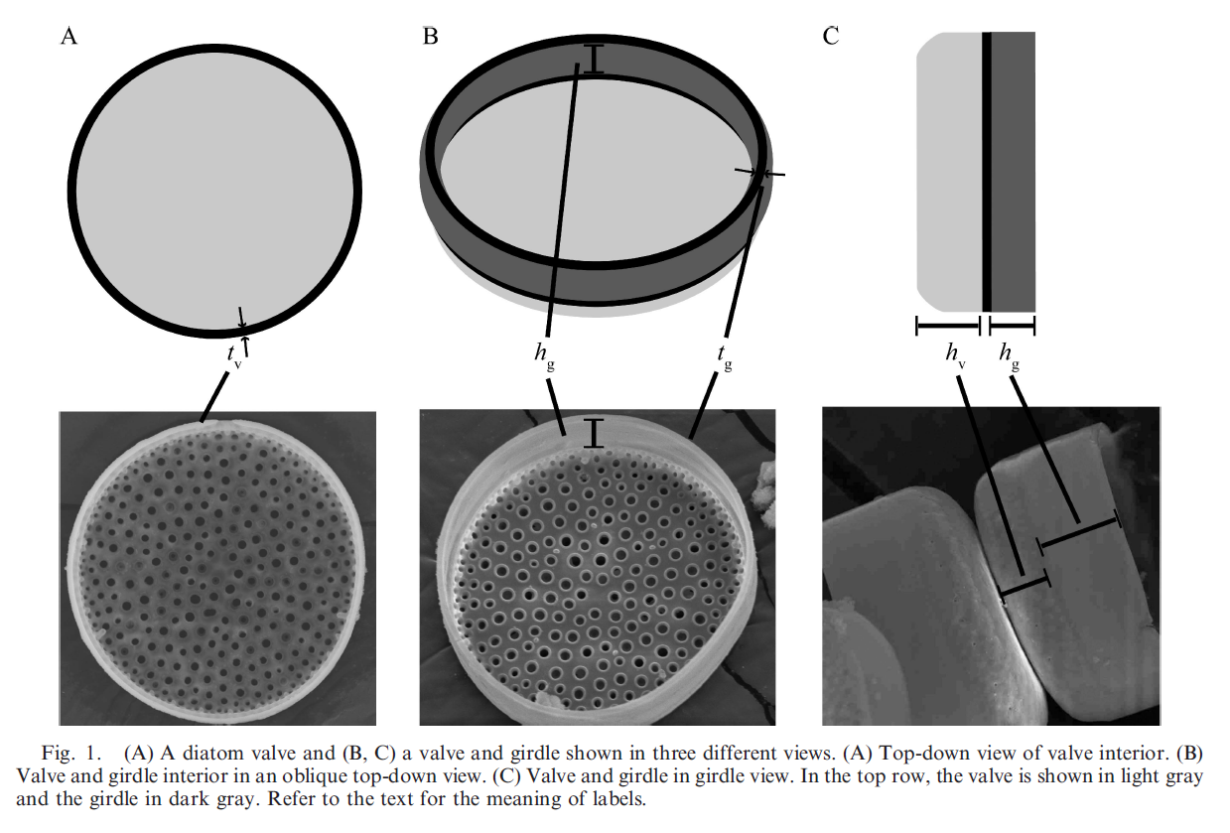
Extended Model
Figure from Miklasz and Denny, (2010). Hopkins Marine Station of Stanford University

Slide 5
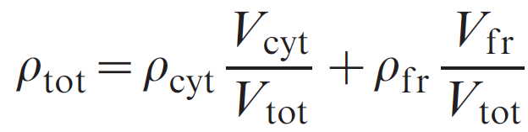
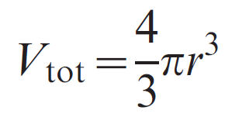
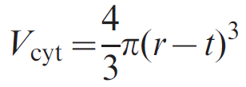
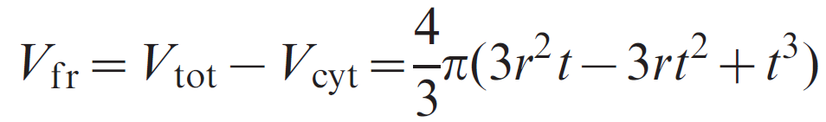
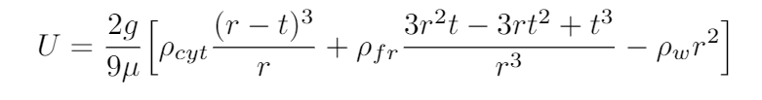
Extended Model
ρcyt is density of diatom cytoplasm
ρfr is density of diatom frustle
t is thickness of the frustle
r is radius of diatom
μ is dynamic viscosity of seawater
g = 9.8 m/s²
Miklasz and Denny, (2010). Hopkins Marine Station of Stanford University

Slide 6
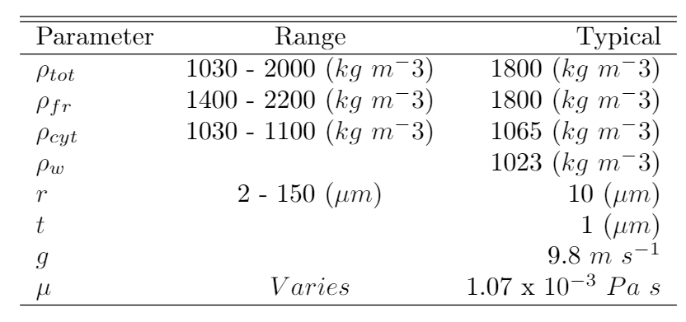
Parameter Ranges

Slide 7

Investigating Dynamic Viscosity
Linear Equation of Density for Seawater
Similarly, dynamic viscosity is affected by Temperature and Salinity.

Slide 8
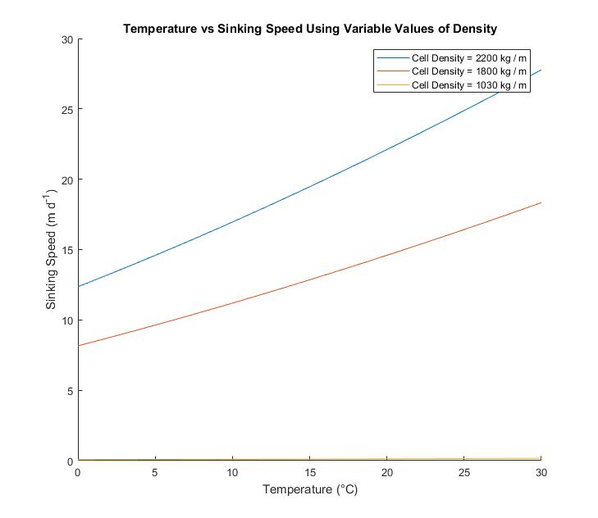
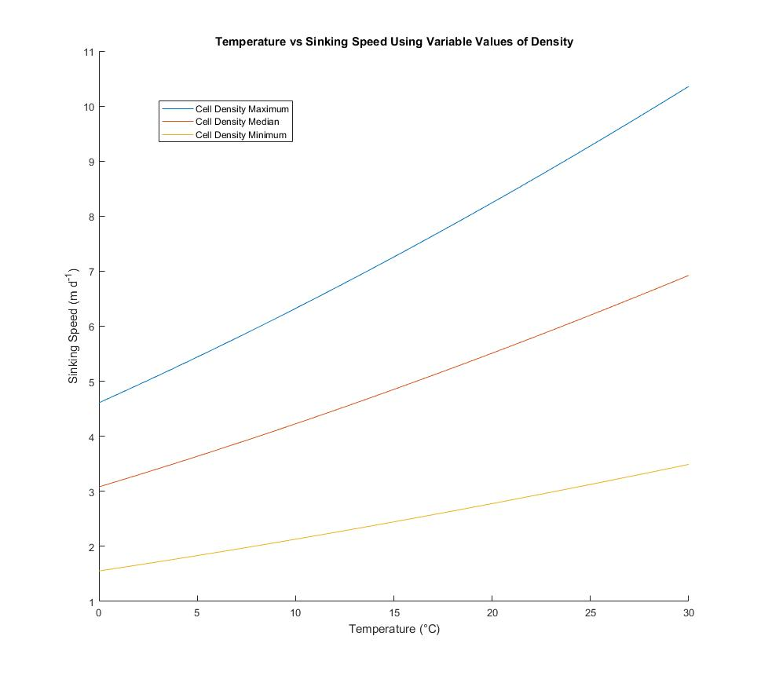
Plot as a function of salinity??

Slide 9
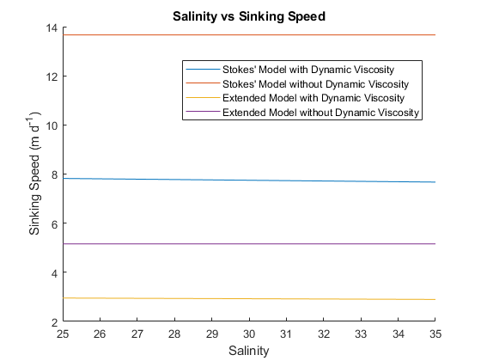
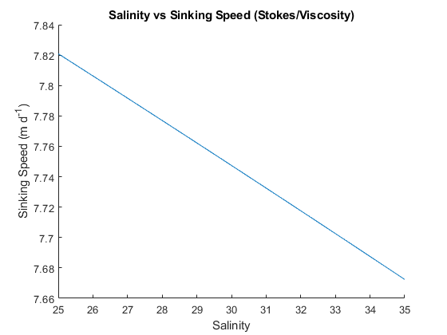

Slide 10
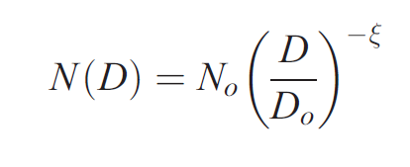
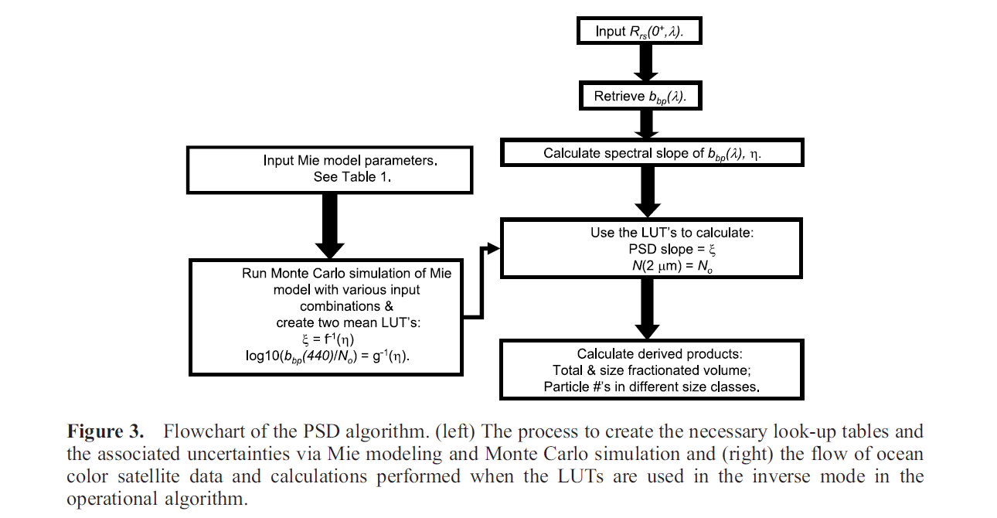
Kostadinov Et Al 2009 (The Retrieval of Particle Size Distribution)
From Kostadinov Et Al (2009), UC Santa Barbara

Slide 11
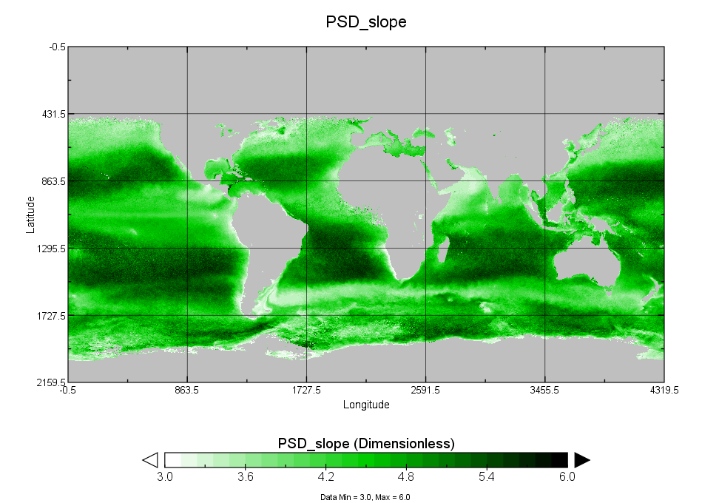
Data Output Particle Size Distribution Slope

Slide 12
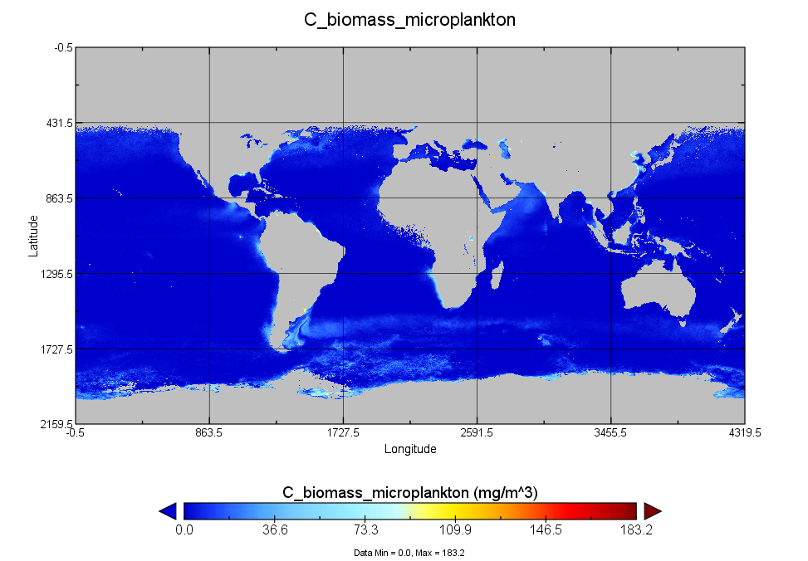
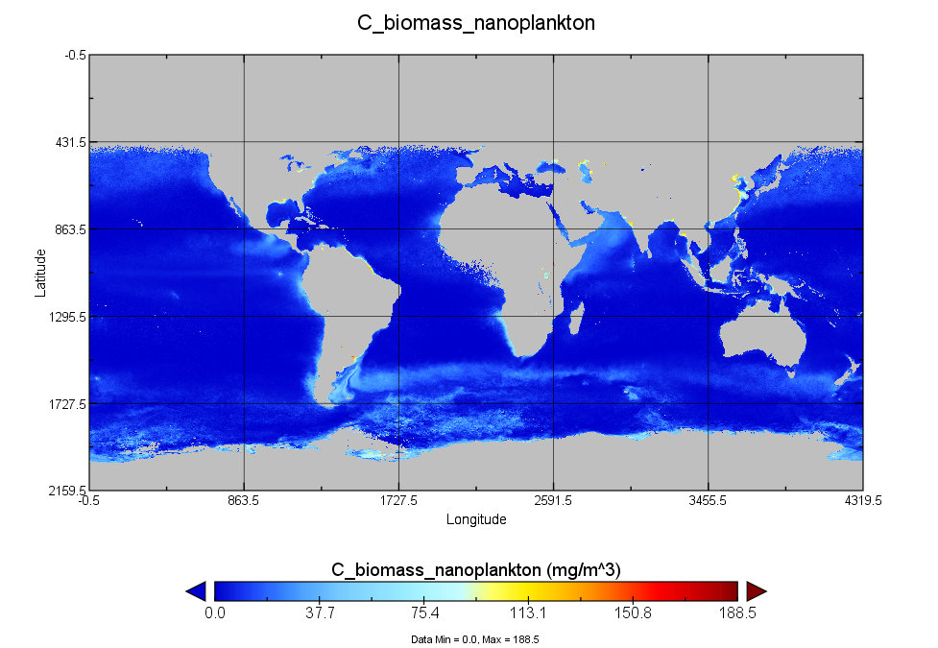
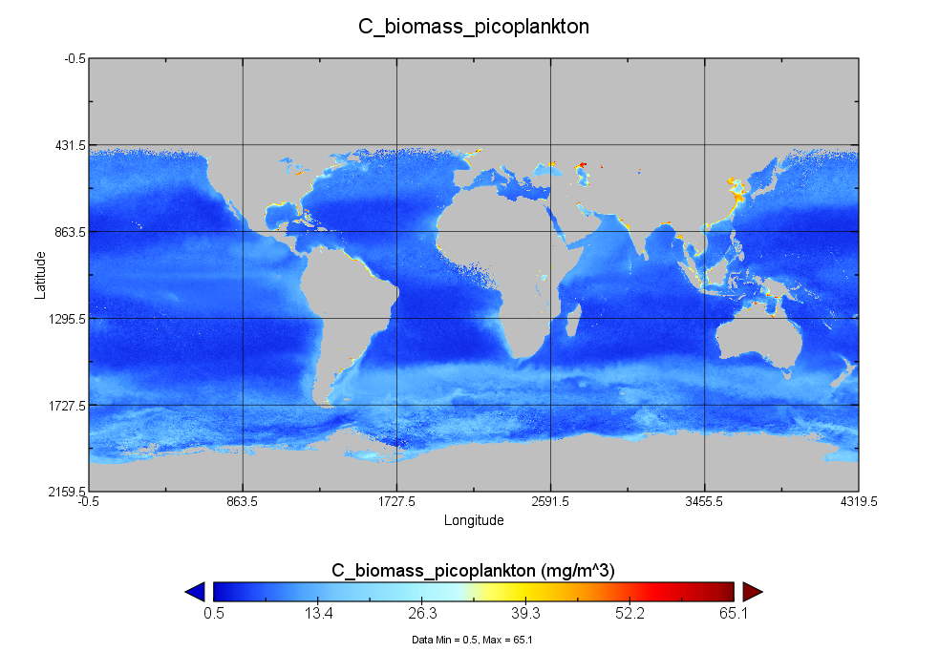
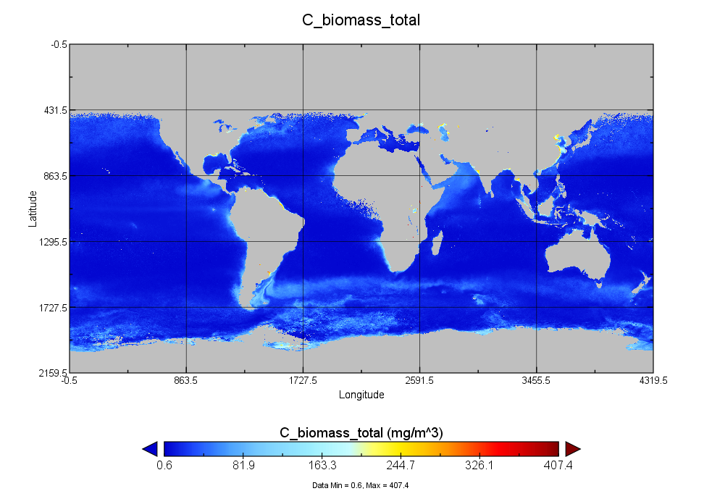
Data Output Biomass Percentages for each size class

Slide 13
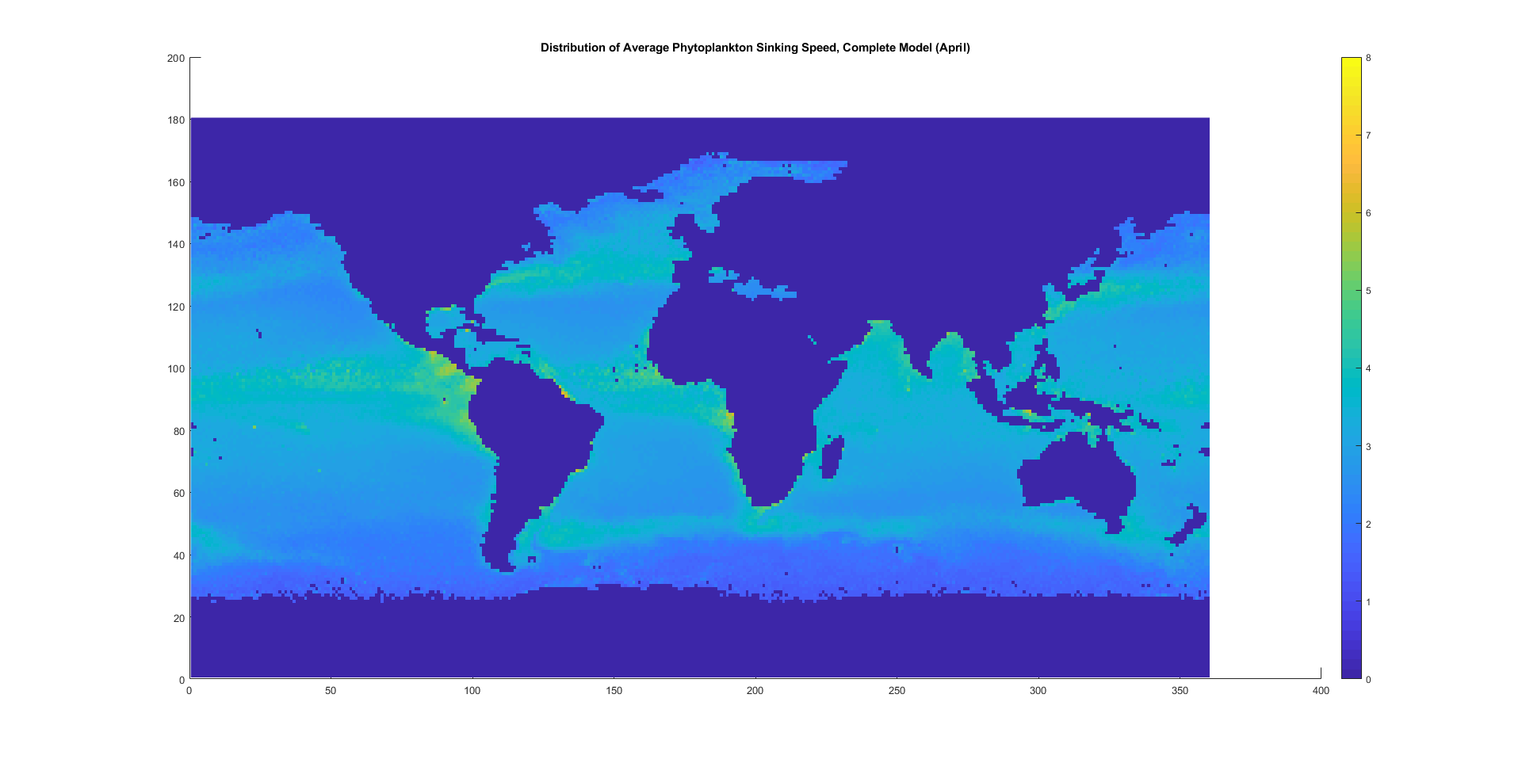
Sinking Speed Prediction First Try
Pico = 1um, Nano = 10 um, Micro = 35 um

Slide 14
Temperature Data from WOA Decade Average
Salinity Data from Aquarius
PSD from Kostadinov et al 2009
Pico = 1um, Nano = 10 um, Micro = 35 um

Slide 15
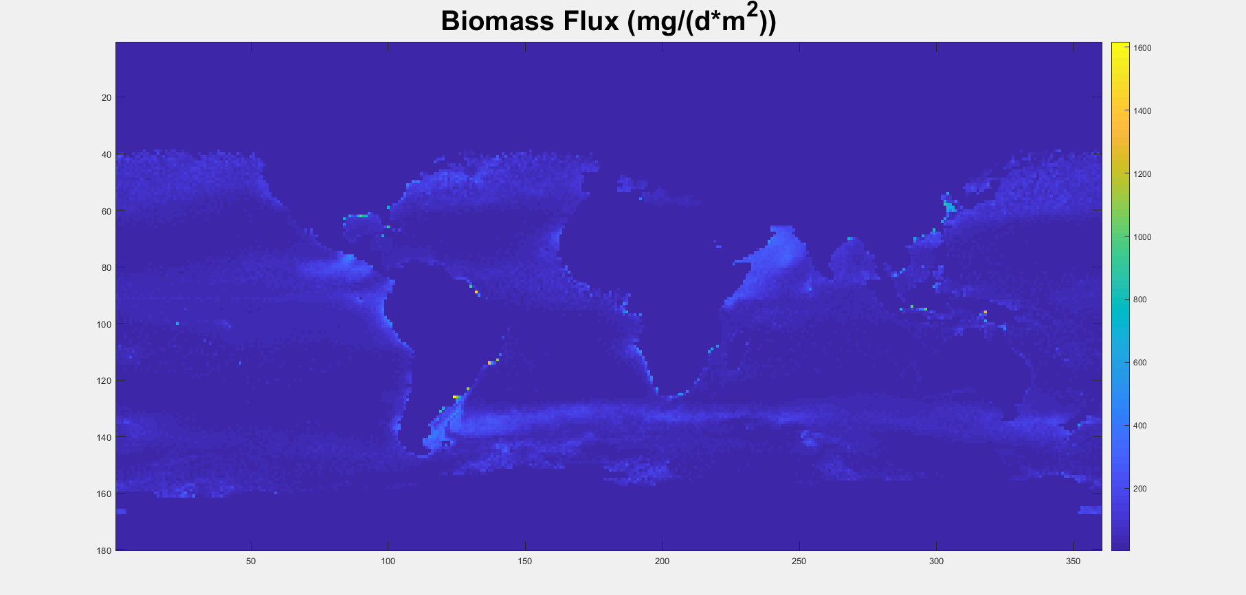
Biomass Export Prediction

Slide 16
Going forward
Compare predictions to carbon sinking data from Greg’s papers
Have started doing statistical analysis
Predict sinking speed at depth from world ocean atlas data

